Slide 1
NuQClq: An Effective Local Search Algorithm for Maximum Quasi-Clique Problem
Topic: Local Search
Date of Publication: 18/05/2021
Paper Source: https://ojs.aaai.org/index.php/AAAI/article/view/17455

Slide 2
Problem Definition
Given a graph G = (V, E) and a fixed constant γ ∈ (0,1], a γ-quasi-clique is a subset S of V such that:
S satisfies the property of clique (i.e. every pair of elements in S should be neighbors)
Density(G[S]) >= γ, where G[S] is the subgraph induced by S, and Density(G) is the ratio between the number of edges in G and the number of all possible edges in G.
The solution to MQCP is to find a γ-quasi-clique S with the most vertices.

Slide 3
Local Search
The local search algorithm maintains a current candidate solution denoted as S which is a subset of V.
It uses two scoring functions to decide which vertex in the graph to operate on:
Primary scoring function:
The adjacency d_{S}(v) of a vertex v ∈ V is the number of vertices in S that are connected to v. The algorithm prefers the vertex with higher value of d_{S} when choosing a new vertex to add, and prefers the vertex with lower value of d_{S} when choosing a vertex to be removed from S.

Slide 4
Local Search
Secondary scoring function:
This function is designed to break ties of the first function. The edges are distinguished into three types according to a function denoted by λ(e), and it is evaluated on every edge in the graph:
λ(e) = 0: this means that none of the vertices of e is included in S
λ(e) = 1: this means that one of the vertices of e is included in S, e is called critical edge in this case.
λ(e) = 2: this means that both vertices of e are included in S, e is called full edge in this case.

Slide 5
Local Search
Intuitively, we should pick vertices which share more edges. A mechanism that encourages converting critical edges to full edges would help to achieve this
The algorithm prefers the vertices that are incident to more critical edges when choosing a new vertex to be added to S.
The algorithm prefers vertices that are incident to fewer full edges when choosing a vertex to be removed from S.

Slide 6
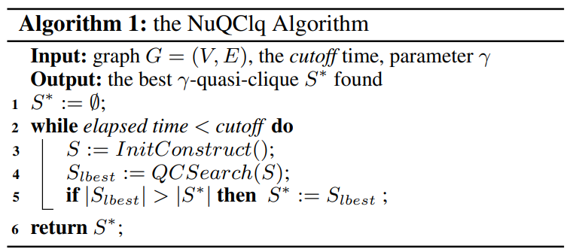
NuQClq Algorithm
The method InitConstruct selects a vertex with the lowest frequency value then it performs some iterations until the set can’t be expanded more and returns the candidate set.
The method QCSearch takes the candidate set as an input. Then, it iteratively modifies the set by using the scoring functions and returns the best local set (S_{lbest}).

Slide 7
Configuration Checking (CC)
It is a diversification strategy that aims to reduce the cycling problem in local search algorithms.
When selecting a vertex to be added to the candidate solution, check its configuration which is usually identified by the states in the neighborhood of the vertex (i.e., in S or not in S).
Dynamic-threshold configuration checking (DCC) allows adding a vertex v if a certain number of vertices in the neighborhood of v have been added to S and is controlled by a dynamic threshold which is incremented whenever v is added to S.

Slide 8
Paper’s Scientific Contribution
The paper proposed a new CC strategy named BoundedCC which overcomes the problems of the DCC which has no limit on the threshold preventing some vertices from being added to the solution for a long time.
This is done by setting an upper bound on the threshold so that no vertex is forbidden for a long time and whenever the threshold exceeds the upper bound, its value is resetted to one
This makes the maximum threshold value 1.5 times more than the average threshold value (against 6.3 for DCC).

Slide 9
Thank You

